Slide 1
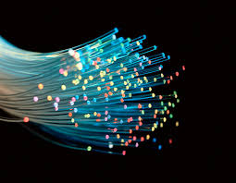
Introduction to Fiber Optics

Slide 2
Fiber Optics
Fiber optics is a branch of Optics that deals with the study of propagation of light(rays or modes) through transparent dielectric waveguides, e.g., optical fibers.
The term Fiber Optics was coined by N.S. Kapany in 1956 at Imperial College of Science and Technology, London in their image transmittting device
“Flexible fiberscope”

Slide 3
What are optical fibers
Thin strands of pure glass
Carry data over long distances
At very high speeds
Fiber can be bent or twisted

Slide 4
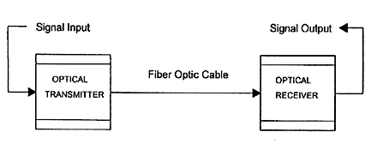
Fiber optic Communication System
Sources
Transmission medium(channel)
Detectors
Fig: The fiber optic communication system

Slide 5

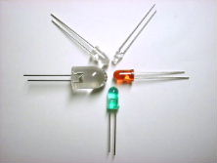
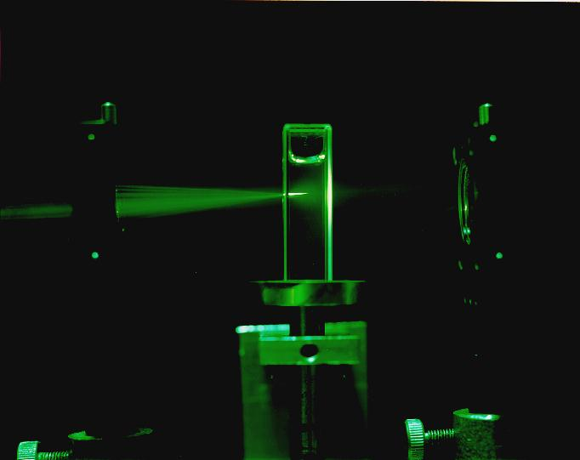
Sources of light
Light emitting diodes
Lasers

Slide 6
Sources
Modulate electrical signals into optical signals
Mostly modulate at 850nm, 1300nm and 1550 nm
Lasers give high intensity, high frequency light
LEDs are economical

Slide 7
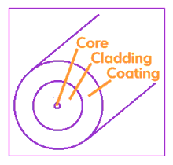
The Channel
Optical fiber is replacing copper
Light as the carrier of information has properties that can be modulated: Amplitude, Phase, Frequency, State of polarization
The optical fiber

Slide 8

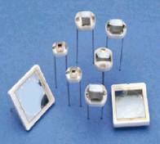
Detectors
Photodiodes
LDR
Fiber Optic Sensors

Slide 9
Physics behind workingof optical fibers
Index of refraction of material : ratio of speed of light in vacuum to speed of light in medium
Refraction of light : bending of light as it travels from one media to another

Slide 10
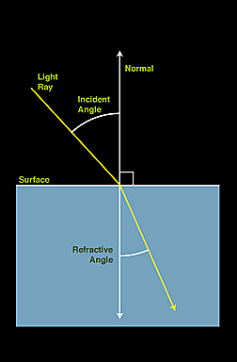
Refraction of light
Speed of light changes as it across the boundary of two media
Angles w.r.t normal

Slide 11
Refraction Indices
Vacuum…….1.00000 (exactly)
Air ……1.00029
Alcohol ......1.329
Diamond ...... 2.417
Glass ........ 1.5
Ice ....... 1.309

Slide 12
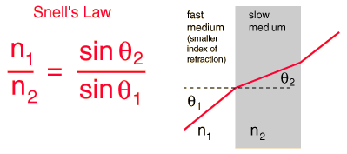
Snell’s Law
Critical angle: Angle of incidence at which angle of refraction = 90⁰

Slide 13
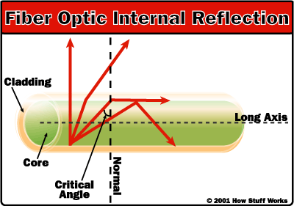
Total internal reflection
Trapping light in the fiber

Slide 14
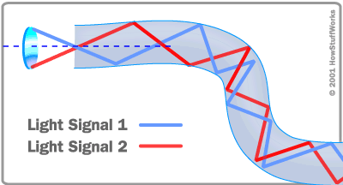
Fibers can be bent!!
Fig: Illustration of total internal reflection

Slide 15
Advantages
Large BW
Small Size
Light weight
Low Loss(0.2dB/km)
Free of radiofrequency and Electromagnetic interference(RFI,EMI)
Highly Secure and Cost

Slide 16
Types of optical fibers
Single mode
  only one signal can be transmitted
  use of single frequency
Multi mode
  Several signals can be transmitted
  Several frequencies used to modulate the signal

Slide 17
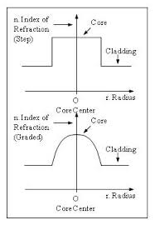
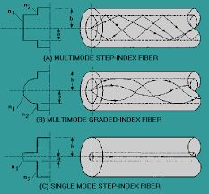
Step Index and Graded Index

Slide 18
Losses in optical fibers
Attenuation loss
Dispersion loss
Waveguide loss
Loss α(dB) = 10 log(P/P’), if P’/P =2, then Loss = 10 log(2) = 3dB

Slide 19
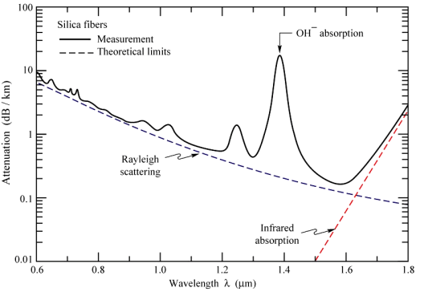
Loss...

Slide 20
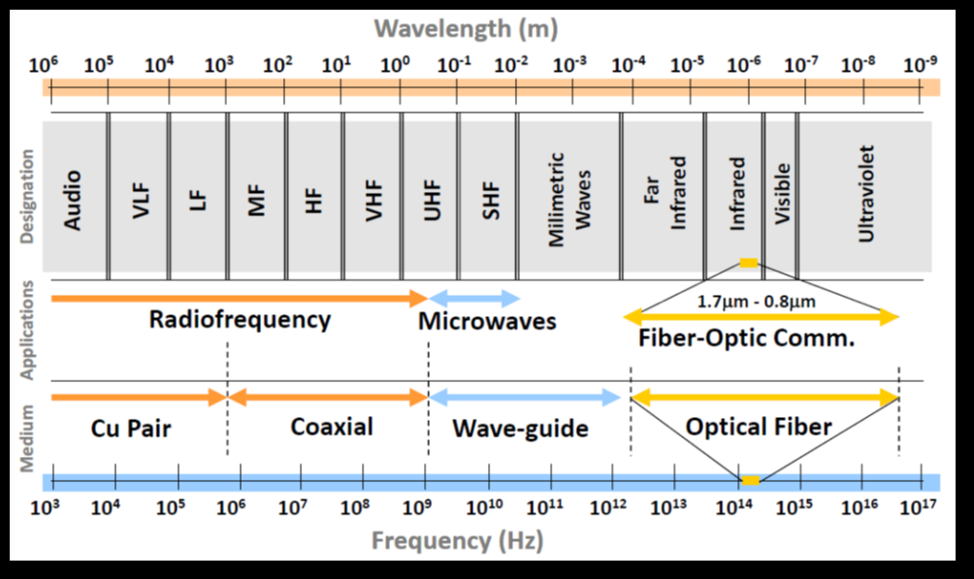

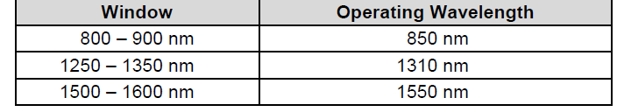
TRANSMISSION WINDOW

Slide 21
Lasers are used for 1310- or 1550-nm single-mode applications.
LEDs are used for 850- or 1300-nm multimode applications.
These wavelengths best match the transmission properties of light sources and transmission qualities of optical fiber.

